Slide 1
Wadleigh Memorial Library
2020 vision

Slide 2
Libraries Transform Lives
3 stories where patrons have changed their lives with the help of the library
> Tanya the nursing student
> Joe the veteran
> Richard the retiree
Notes:
Tanya moved to Milford in the midst of her LPN exam training course. She had no vehicle or access to her class in Nashua but heard the library had resources to help her. She was able to borrow a current text book and use a free online course available through the library to finish her studies. She finished her LPN exam with flying colors! Learning Express is an free online class system available to anyone with a WML card.
Joe the veteran received a letter telling him to go online to complete his benefits application. He had little experience but heard the library had people who could help him. The staff got him logged on to the correct website where he was able to fill out all the necessary forms. He is now receiving his well-deserved benefits. WML staff is trained to provide technical assistance to folks of all skill levels – no question is too “dumb”.
After retiring from an active sales career, Richard grew lonely and despondent. His family became concerned and began researching communities that would provide him with the learning opportunities and social connections he sorely missed. They learned Milford has a library within walking distance of retirement housing – a library with newspapers, friendly staff and lots of programs and activities for senior citizens. Richard moved to Milford and became a daily fixture in the library and has become more healthy, upbeat and is expanding his knowledge every day.
Libraries transform lives.

Slide 3
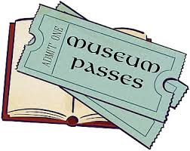
Kindle and Google?
Notes:
Some people say that libraries are obsolete and you just need your Kindle and Google. That vastly underestimates the services the library provides and the place it plays in the community for many people. Let me talk about that:
Library offers following services:
Free access to books (both local and from the GMILCS library sharing)
DVD/BluRay Movies available for lending
Music CDs available for lending
Total of 177,816 physical items checked out last year
Access to periodicals, magazines, and newspapers (typically not available for free online)
Museum passes that are free to Milford library card holders including
Museum of Fine Arts, Boston
Currier Museum of Art, Manchester
McAuliffe-Shepard Discovery Center, Concord
Museum of Science, Boston
New England Aquarium, Boston
NH State Parks
Many more!
Meeting space for non-profit groups serving the educational, cultural, or civil needs of Milford as well as small groups, study rooms, etc.
Free Wi-Fi internet access
Telescope available for use
Public Notary and Passport application agency
MANY very popular children’s programming
Live music programs held in the library
Movies shown in the library – free!
Access to a 3D-printer (just pay for materials)

Slide 4
Where We Are
1986 – Library last renovated (34 years ago!)
20 years - Expected life of mechanicals and space
14 years past life expectancy!
Systems are failing and building is not meeting town needs
Other Town Building issues have been addressed: Town Hall, DPW, Police, Fire, Ambulance, Welfare and Schools.
Notes:
Some numbers for 2019:
Registered patrons: 9,381
Patron visits (based on library door counters): 114,812 – approx. 300 per day, more than any other town facility
Total Circulation (books, ebooks, DVDs, Music CDs, Museum Passes, GMILCS, etc): 177,816
Library events (children’s and adult): 735 with a total attendance of 16,535
Meetings held at the library: 985 with a total attendance of 4048
Highlight that all other town buildings have either been newly built or had major renovations since the last time the library was addressed.

Slide 5
It’s Time to Fix One of the Most Used Buildings in Town
$218,335 - Amount Trustees have invested in library repairs since 2016 from donations, grants and other income
$58,862 – Amount the Town has contributed during that same time.
Notes:
In the first 2 weeks of January, $8546 was spent to repair the roof chiller; It was repaired at the cost of $16796 over the past 3 years, including 2020.
There is no sprinkler system.
5 of 6 electrical panels are obsolete and dangerous.
There are visible cracks in the cast iron pipe encased in the concrete floor, there have been sewer backups and a bathroom on the 3rd floor that is not functioning properly.
The roof is leaking and causing windows to rot
The Palladian window in the 1986 addition has failed and is not efficient
There is a drainage issue due to drainage pipes being damaged during construction in 1986 resulting in water coming into the basement when it rains.
Only 1 handicap parking space.
It is more expensive to make emergency repairs than it is to deal with issues before they fail. The trustees need to address the issues with the grounds and facility in a more comprehensive way in order to avoid wasting any additional funds

Slide 6
Why Invest in the Library?
> Residents want to preserve access to what they already own
> Safe, Accessible and Accommodating for All
> Flexible for the Future
> Provides MANY services for the community

Slide 7
Trustees’ Response to the Community
A series of community discussions were held
A space planner was hired to study the flow of patrons and service points.
The community group recommended a library renovation with a small expansion to cost no more than $3 million
Notes:
After previous warrant articles failed to get the necessary 2/3 majority, the library trustees embarked on an effort to understand what the community wanted to do with the library and how to best meet the needs expressed by the town.

Slide 8
Value for Your Money!
Bring building up to current code
Fix failing mechanical systems
Renovate existing space to provide better use
Small addition to add much needed additional space
Deliver to the Town the Library that people have been asking for
Notes:
Trustees have worked VERY hard to make sure the proposed project fixes the issues I've talked about from mechanical to space usage to how the library is used. This is NOT a Taj Mahal - it follows the input we've gotten from citizens and tries very hard to be the most cost effective choice we could make

Slide 9
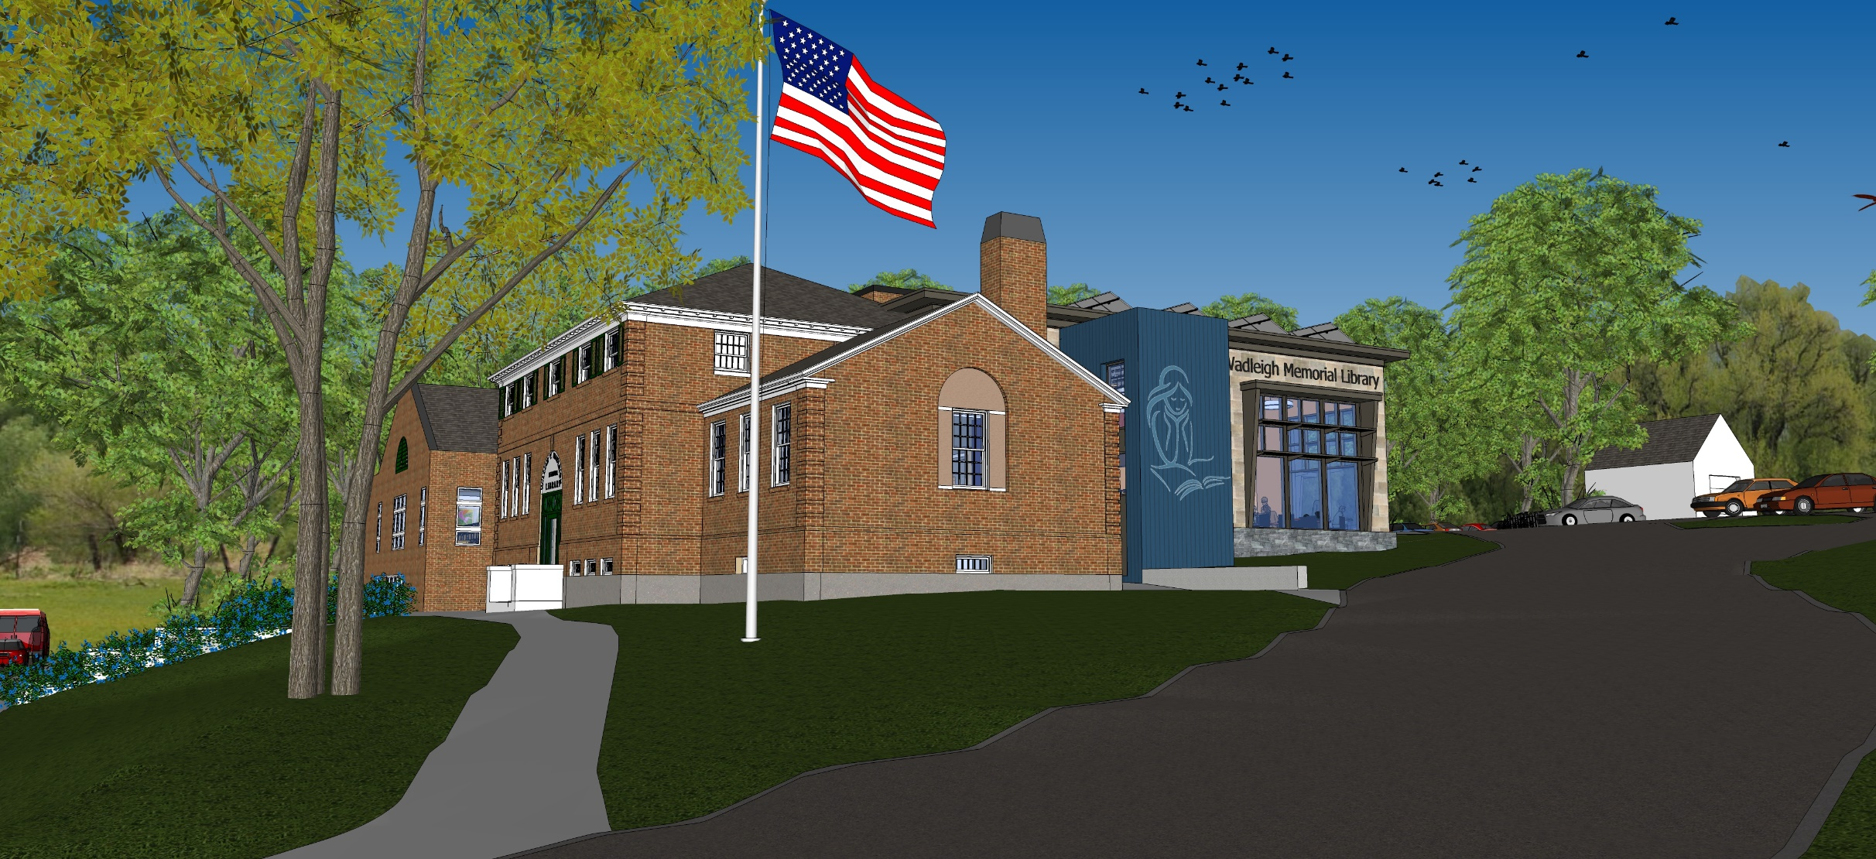
Library “Expanovation” Project
Notes:
We’ve been working with Jason LaCombe of SMP Architecture since late 2018. We’ve gone through several iterations and decided this was the very best option for the library and the town. Here is Jason to explain more.

Slide 10
Budget
Notes:
The Trustees’ hired SMP Architecture in 2018 to lead the design for an “Expanovation” – a combined renovation with a small expansion to meet the various needs of the library and the town. More detail will be provided by Jason LaCombe of SMP in a moment but this plan will address:
Much needed repairs and updates to the physical systems including HVAC, electrical, plumbing, doors and windows, and installation of a sprinkler system for fire protection. The last major investment in update of these systems was done in the 1986 renovation (34 years ago – and was meant to meet the needs of the town for the next 20 years – now at almost twice that time)
Renovation and reconfiguration of the existing space to better meet the needs of the community and library staff including a much updated program space for children’s and other programs, a relocated and enlarged teen space, relocation of the circulation desk for better lines of sight throughout the library and a better flow for staff and patrons.
A small expansion that will provide much needed additional meeting space and additional public space as well as addressing the accessibility issues with the current main entrance.

Slide 11
Total Project Budget
Includes:
Construction Costs

Slide 12
Total Project Budget
Includes:
Construction Costs
Furniture, Fixtures, and Equipment
Soft Costs

Slide 13
Total Project Budget
Includes:
Construction Costs
Furniture, Fixtures, and Equipment
Soft Costs
Contingencies

Slide 14
Total Project Budget
Includes:
Construction Costs
Furniture, Fixtures, and Equipment
Soft Costs
Contingencies
$3.45m

Slide 15
Total Project Budget
$3.45m
$687,000 currently raised
($500k from trustees, $187k from donations and pledges)

Slide 16
Total Project Budget
$3.45m
$687,000 currently raised
Anticipated Bond
$2.76m
Includes
$415,000 Contingency

Slide 17
Total Project Budget
CM at risk with a guaranteed maximum price

Slide 18
Total Project Budget
CM at risk with a guaranteed maximum price
Funds not spent in the budget are returned to the town

Slide 19
ENTRIES
Existing Library:
LL = 4,849 sf
ML = 8,769 sf
UL = 1,631 sf
Total = 15,249 sf
ENTRY DRIVE

Slide 20
ENTRIES
STAFF
Existing Library:
LL = 4,849 sf
ML = 8,769 sf
UL = 1,631 sf
Total = 15,249 sf
ENTRY DRIVE

Slide 21
OPEN
Existing Library:
LL = 4,849 sf
ML = 8,769 sf
UL = 1,631 sf
Total = 15,249 sf
ENTRY DRIVE

Slide 22
ENTRY DRIVE
THE HUB

Slide 23
ENTRY DRIVE
CIRCULATION
THE HUB
ARRIVAL
ENTRY

Slide 24
CHILDREN
ENTRY DRIVE
CIRCULATION
THE HUB
ARRIVAL
ENTRY

Slide 25
CHILDREN
ENTRY DRIVE
CIRCULATION
THE HUB
ARRIVAL
ENTRY
ADULTS

Slide 26
TEENS
CHILDREN
ENTRY DRIVE
CIRCULATION
THE HUB
ARRIVAL
ENTRY
ADULTS

Slide 27
ENTRY DRIVE
“LOFT”
THE HUB
ARRIVAL
ENTRY

Slide 28
“LOFT”

Slide 29
ENTRY DRIVE
CIRCULATION
THE HUB

Slide 30
ENTRY DRIVE
CIRCULATION
THE HUB
Access to
staff space

Slide 31
Access to
staff space

Slide 32
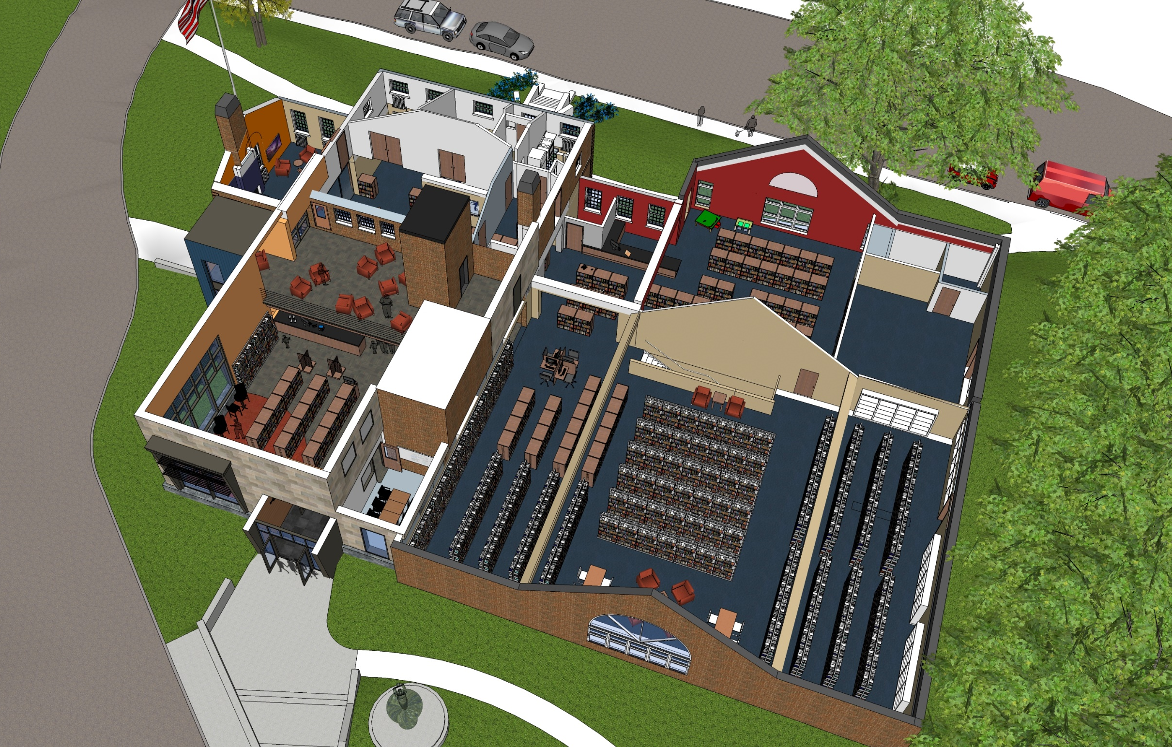
The Hub
Circulation Desk
New Releases
Digital Media
Casual Seating

Slide 33
The Loft
Serve Keyes Meeting Room
Lounge seating
Edge of the action
The Hub

Slide 34
Teen Zone
The Loft
Children's Wing
The Hub
Adult Wing

Slide 35
The Hub
Ready for the future

Slide 36
So…
What’s it going to look like?

Slide 37
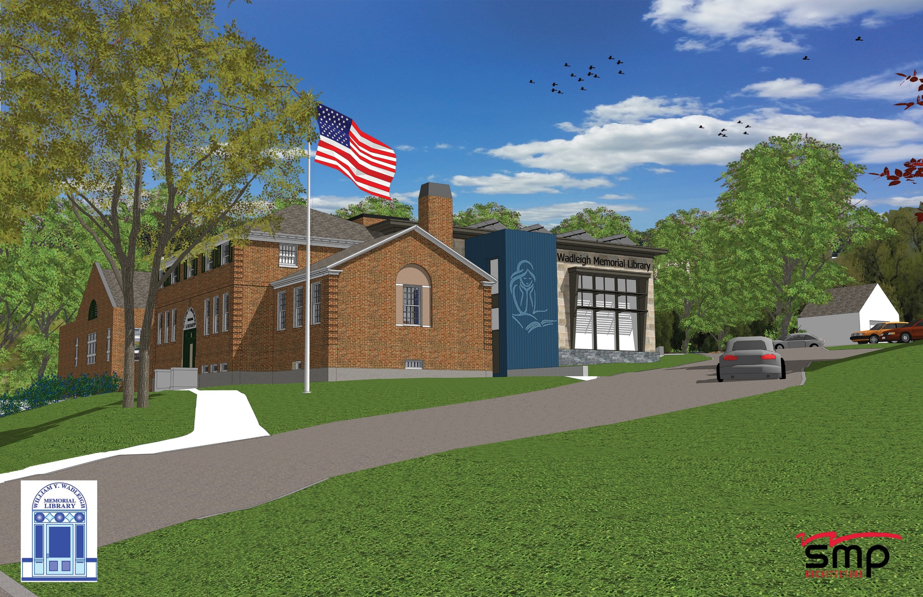

Slide 38
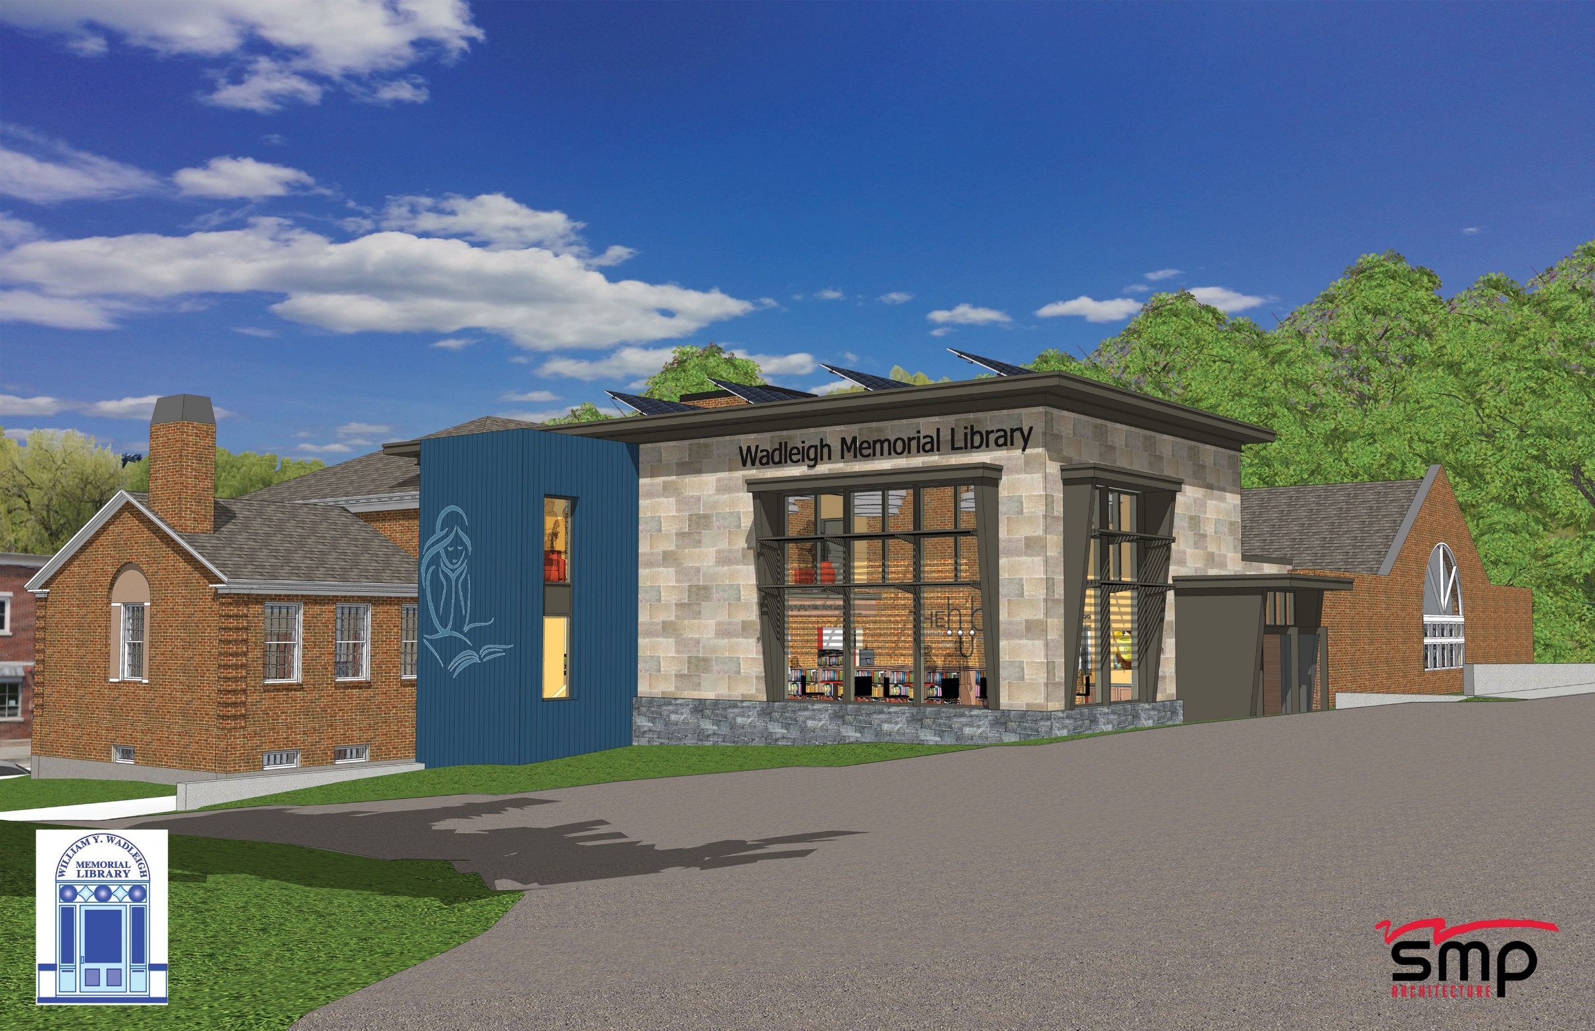

Slide 39
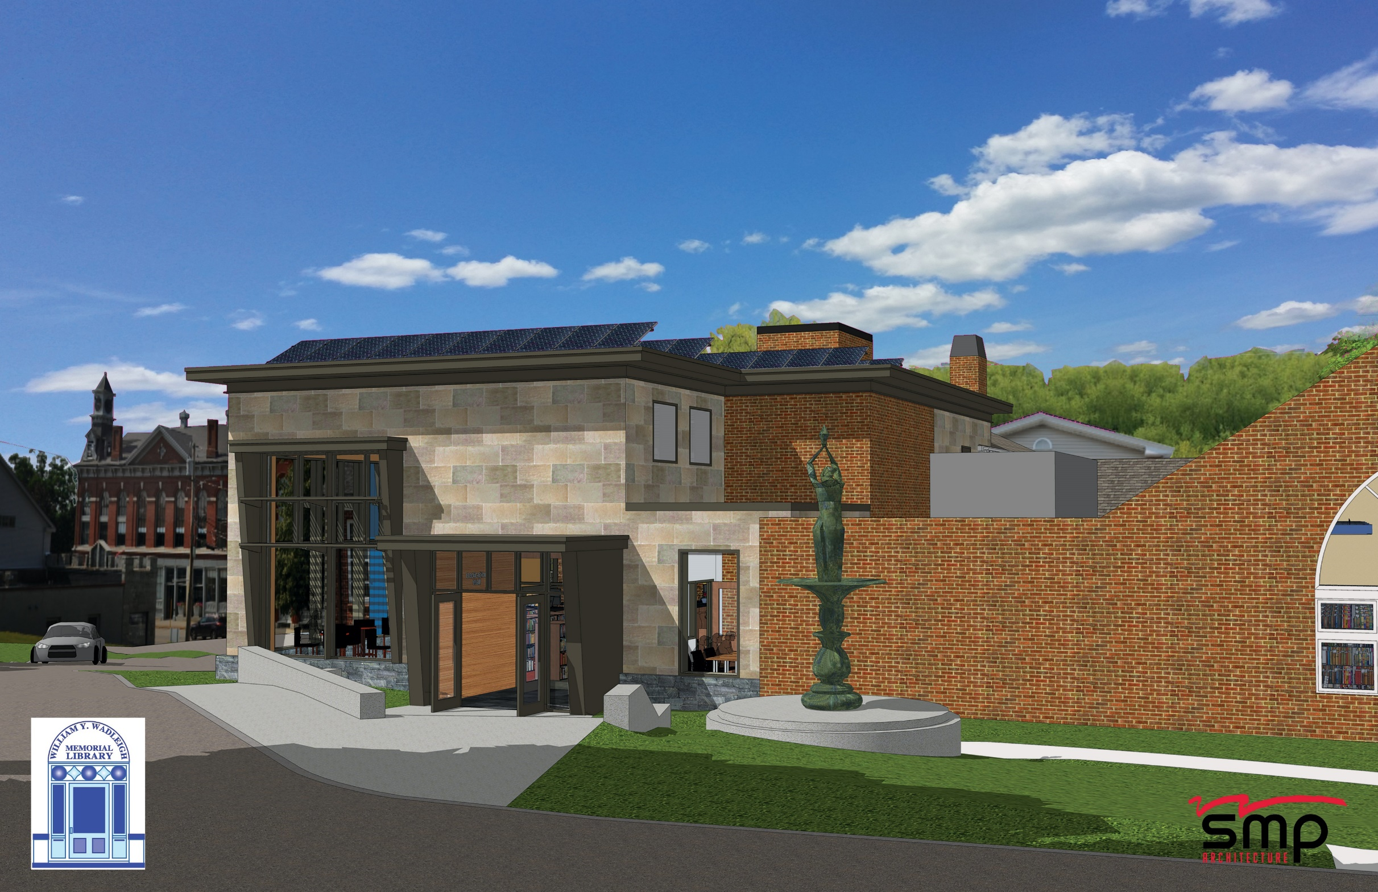

Slide 41
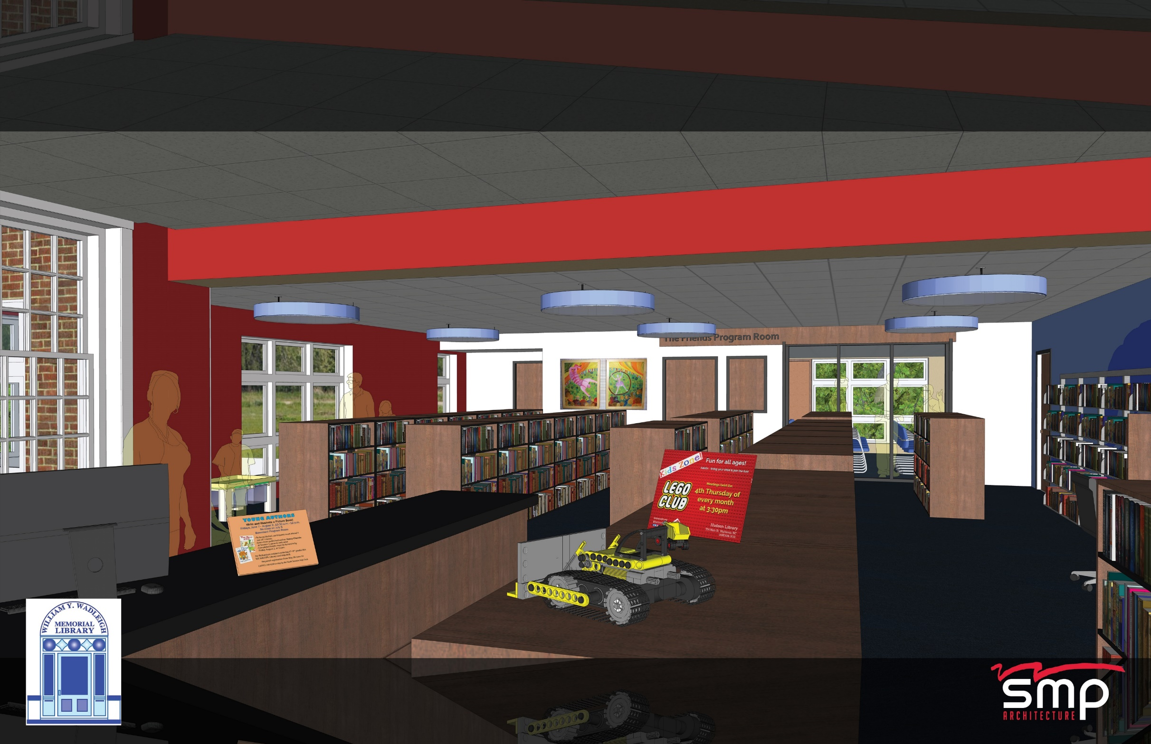

Slide 42
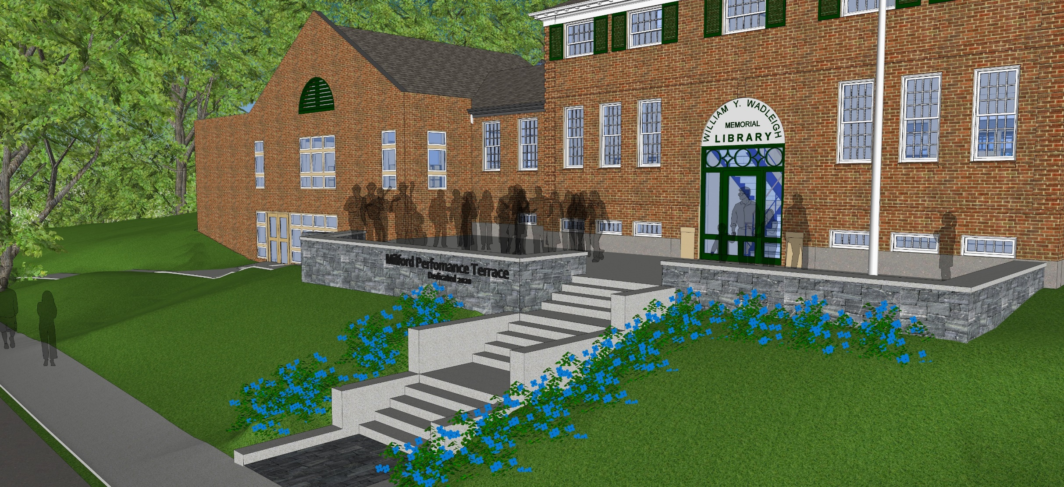
Thank-you
WWW.WADLEIGHLIBRARY.ORG
About Us->Library Expanovation Project

