Slide 1
2020 Deliberative Session Financial Update
Photo credit to Cynthia King

Slide 2
Milford’s Financial Health Remains Strong
2020 Operating Budget
Debt Service
Fund Balance
Non-Tax Revenue
Tax Impact

Slide 3
2020 Proposed Municipal Expense Budget
2020 Operating Budget is $15,261,695
Increase of $497,522 or 3.4% from 2019 Budget
2020 Default Budget is $15,271,749
This is $10,054 more than the proposed Operating Budget.

Slide 4
BUDGET DRIVERS FROM 2019 INCLUDE
Health Insurance - $187,108
Wage increases - $106,181
AFSCME 4% or $47,251
Teamsters 2.5% or $12,266
Other town employees 2% or $46,664
Workers Compensation - $70,583
MS4 Compliance - $44,000
Voter Registration/Elections -$43,425

Slide 5
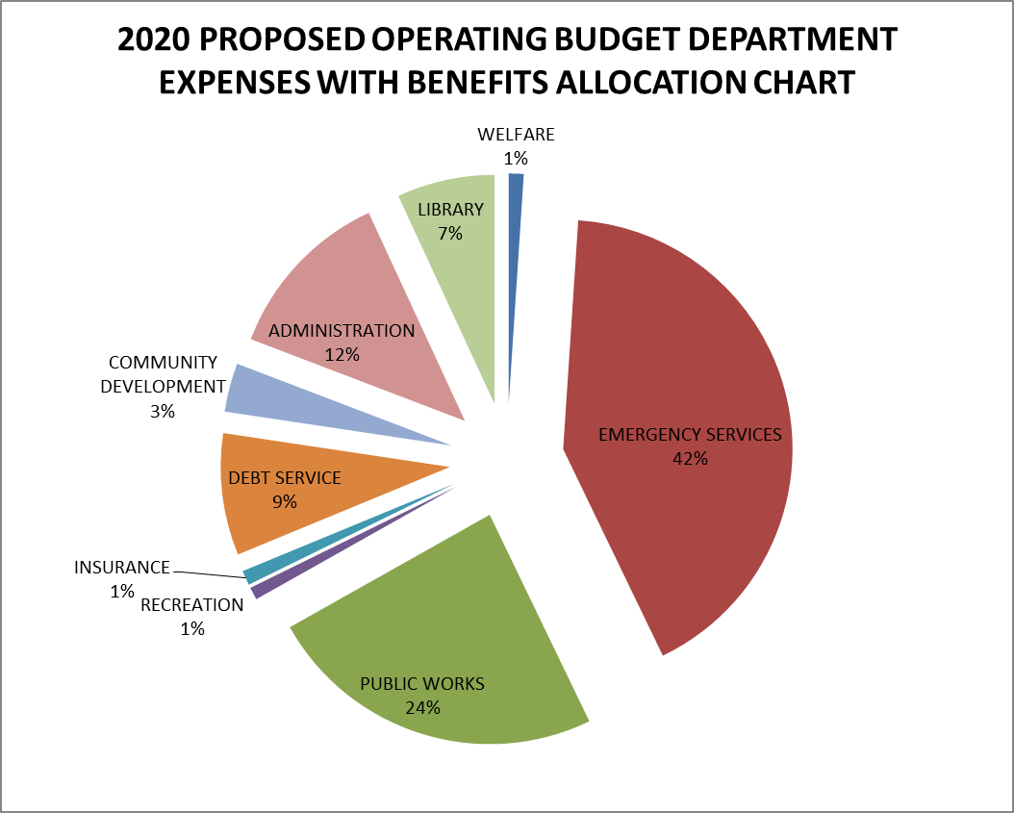
PROPOSED OPERATING BUDGET

Slide 6
2020 Proposed Operating Budget Department Expenses with Benefits Allocation
Department | Amount | %
Administration | $1,877,418 | 12%
Community Development | $524,979 | 3%
Insurance | $158,112 | 1%
Debt Service | $1,311,174 | 9%
Recreation | $135,815 | 1%
Welfare | $159,879 | 1%
Emergency Services | $6,378,453 | 42%
Public Works | $3,662,930 | 24%
Library | $1,052,935 | 7%
TOTAL | $15,261,695 | 100%

Slide 7
DEFAULT BUDGET
Operating Budget FY 2019 (per W/A's 8, 22 & 27) |  |  |  | $14,764,173
FY 2020 DEFAULT BUDGET |  |  |  | $15,271,749
 | Difference |  |  | $507,576
Long Term Debt
FY 2019 - Principal & Interest Long Term Debt |  |  | ($1,324,991)
FY 2020 - Principal Long Term Bonds & Notes |  |  | $1,311,174
 |  |  | Net Change--> | ($13,817)
Contractual & Statutory Expenditures
Health Insurance Increases, Workers Comp, AFSCME & Teamsters
MS4 Mandates, MPD Officer added in 2019, 4 Elections
Solid Waste Disposal, NHRS, MACC Base
Property & Liability Insurance |  |  |  | $460,576
One Time Expenditures
FY 2019 - Highways & Streets vehicle |  |  | Net Change--> | ($47,000)

Slide 8
2020 Proposed Budget Tax Impact
Current municipal tax rate is $5.74. The Municipal portion of the tax rate has decreased each of the past four years.
Non-tax revenue is projected at $6,494,442
Selectmen voted to use $750,000 from the Fund Balance to reduce taxes.
Net property assessment is projected to increase 1.1% to $1,618,557,667.
If the 2020 proposed operating budget and all warrant articles are approved and we apply the $750,000 from Fund Balance, the municipal tax rate would increase 2.1% to $5.86

Slide 9
OPERATING BUDGET VS. ACTUAL HISTORY, 2012-2019
 |  |  |  | Actual to
 | Year | Budget | Actual | Budget
 | 2012 | $ 11,832,885 | $ 11,541,782 | 97.5%
 | 2013 | $ 12,447,557 | $ 12,291,430 | 98.7%
 | 2014 | $ 13,025,297 | $ 12,853,549 | 98.7%
 | 2015 | $ 13,675,218 | $ 13,416,226 | 98.1%
 | 2016 | $ 13,804,411 | $ 13,616,906 | 98.6%
 | 2017 | $ 13,973,281 | $ 13,715,298 | 98.2%
 | 2018 | $ 14,081,843 | $ 13,848,007 | 98.3%
 | 2019 | $ 14,764,173* | $ 14,707,000 | 99.6% | Estimated
*Includes $160,000 Encumbered funds for items that were removed from the 2020 Proposed Budget.

Slide 10
DEBT RATIO
Low Debt: 31% of statutorily allowed maximum.
The State of NH requires that a town’s debt ratio cannot exceed 3% of its equalized valuation (RSA’s 33:4-a & 33:4-b):
Maximum allowed debt is $48M – our current debt is $14.7M or 0.9% of equalized valuation.

Slide 11
DEBT RATIO
 |  |  |  | Percent of
 |  | Millions |  | Allowed Maximum
Actual debt - year end 2019 |  | $ 14.7 |  | 31%
Debt increased $2.9 million from 2018 Water Utilities is $5.1 million Town debt at $9.6 million
2020 projected additional debt |  | $ 5.7
(Library, Dispatch, Ambulance, Loader and Wastewater Management)
2020 debt payments |  | $ (1.5)
Estimated debt - year end 2020 |  | $ 18.9 |  | 39.4%

Slide 12
FUND BALANCE & NON-TAX REVENUE
Fund Balance: Steady Growth in the Fund Balance from 2015 - 2019
$4,451,273 (2019 year end estimate)
10.7% of Town, School & County Net Appropriation
Selectman voted to use $750,000 from the fund balance to reduce the 2020 tax rate. Projected balance at 12/31/20 is $3,701,271 or 8.9%
Non-Tax Revenue was flat in 2019
2019 Actual Revenue $6,461,650
Projecting 2020 revenue of $6,494,442
Non-Tax Revenue includes Vehicle Registrations, Ambulance Fees, Rooms & Meals allocation, Highway Block Grant, Anticipated Municipal Aid, etc.

Slide 13
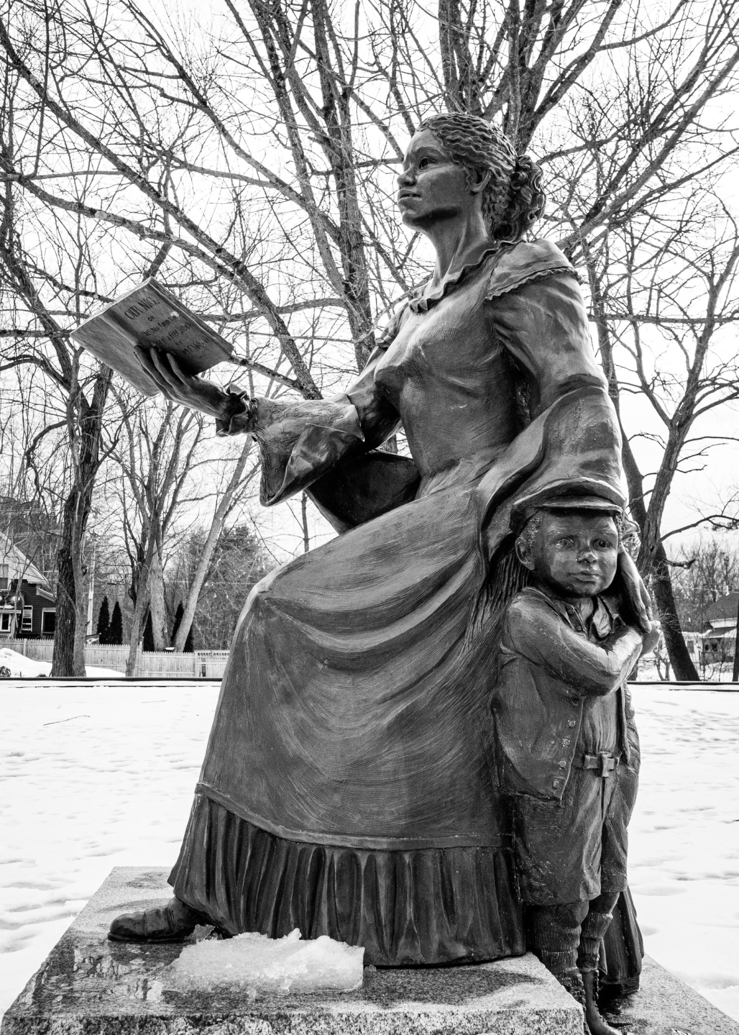
Questions?
Photo credit to Shannon Burstein

