Slide 1
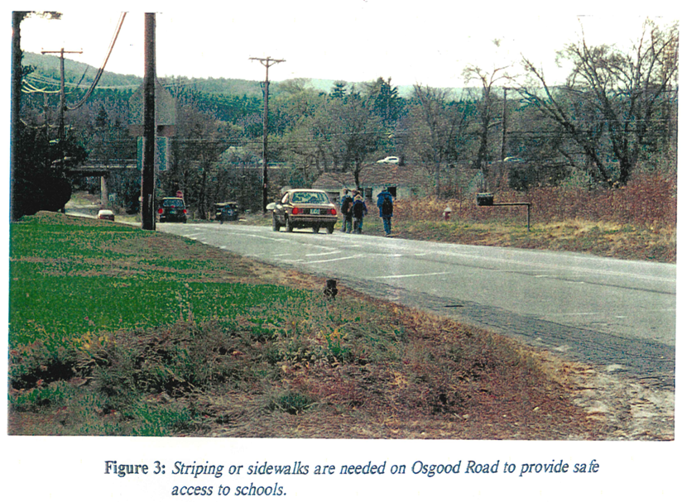
- Warrant Article 25 -
OSGOOD ROAD, MELENDY ROAD, & ARMORY ROAD PEDESTRIAN SAFETY SIDEWALK
& BICYCLE LANE PROJECT
Presented By:
Town of Milford
Office of Community Development
January 30, 2021

Slide 2
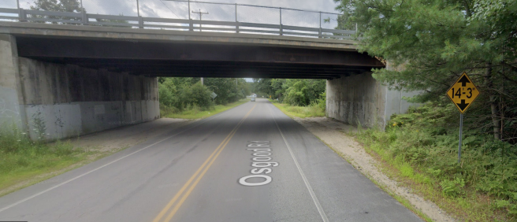
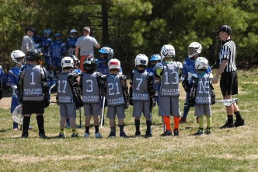
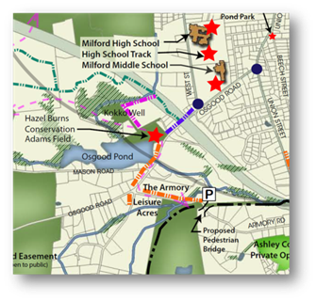
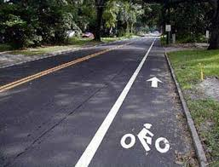
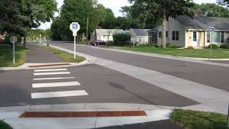
PURPOSE & INTENT
Creates a dedicated pedestrian connection between the Milford schools, Hazel Adams Burns Park, Osgood Pond, the adjacent established residential neighborhoods, existing trail network system, and the downtown area.
Improves safety along a heavily traveled corridor for students, residents, walkers, and cyclists.
Reduces traffic on the Town's roadway network. (Osgood Road - 3,340 ave. vehicles per day, NHDOT 2020).
Improves walkability and provides opportunities for people to be physically active.
Represents an integral part of the Town’s long-term goal to improve pedestrian safety, traffic management, and connectivity.
80% of the project is funded by the Federal Highway Administration and NH Dept. of Transportation.
– Article #25 –

Slide 3
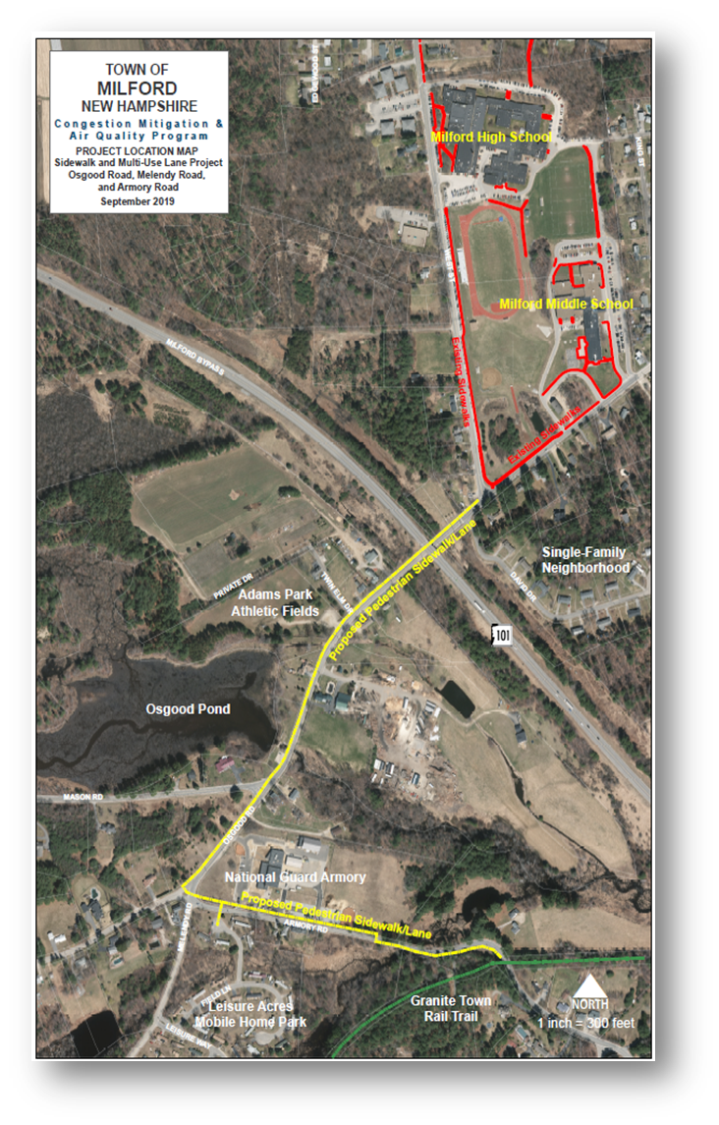
PROJECT SUMMARY
Existing Sidewalks
Approximately 4,000 linear feet of dedicated pedestrian improvements:
1,800’ of dedicated sidewalk and adjacent bike lane.
2,200’ of dedicated multi-purpose sidepath or sidewalk.
Drainage/stormwater management and paving improvements.
Pedestrian intersection, crosswalk, and lane marking improvements.
Installation of pedestrian signage.
Proposed Improvements
– Article #25 –

Slide 4
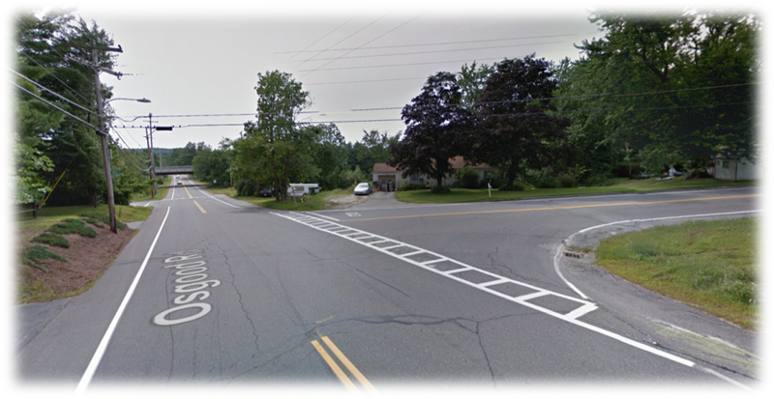
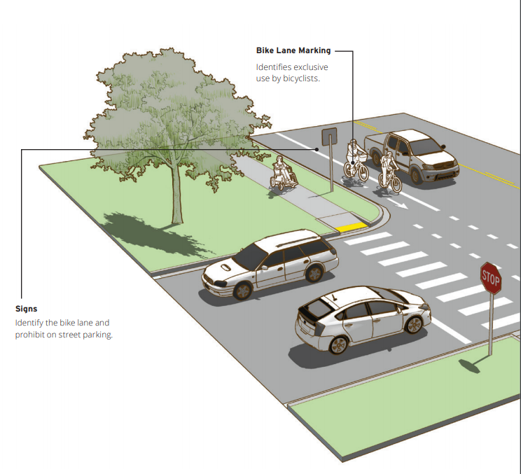
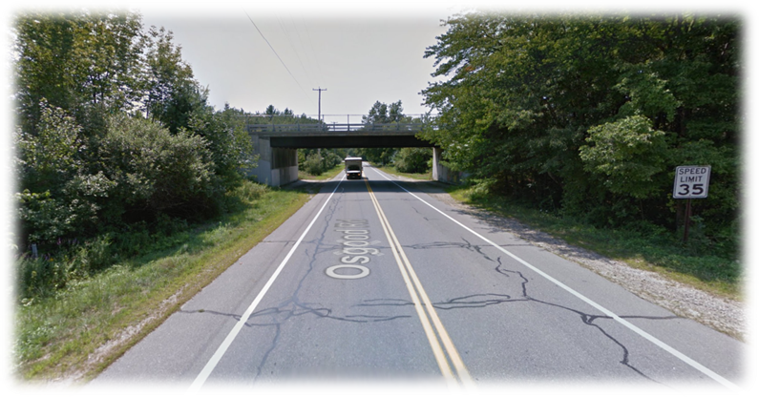
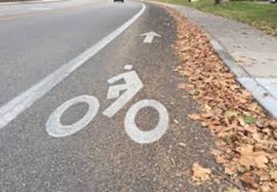
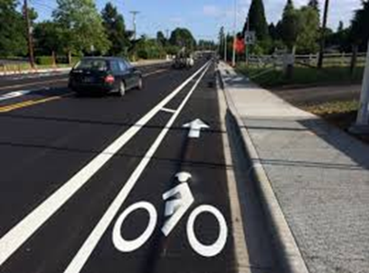
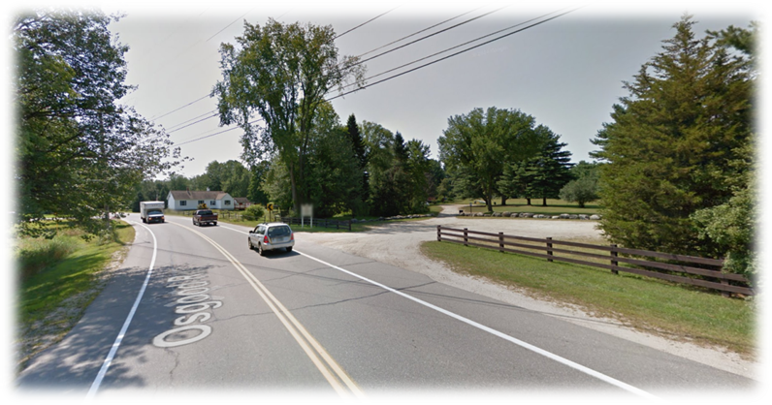
PROJECT SUMMARY
West Street
– Article #25 –

Slide 5
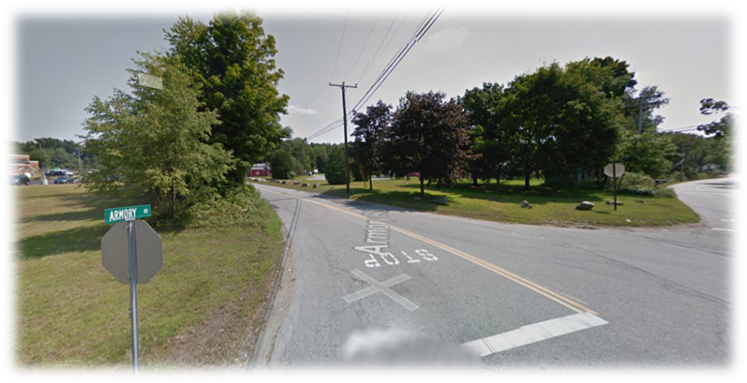
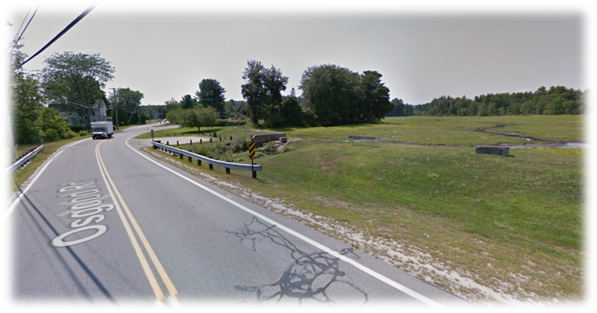
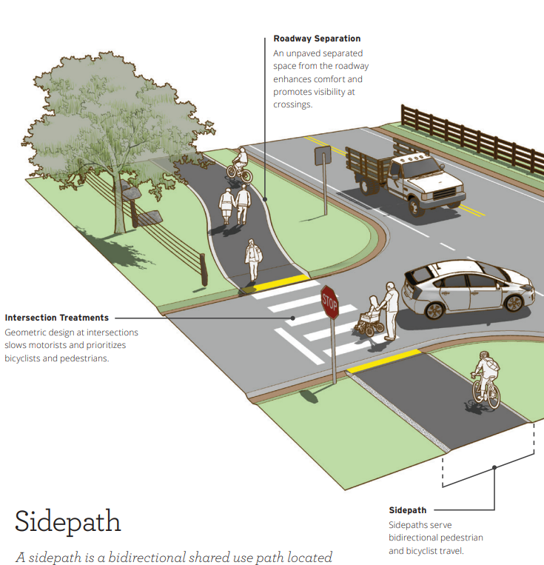
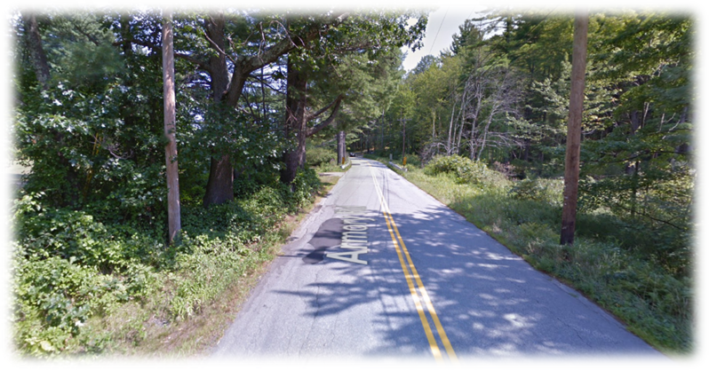
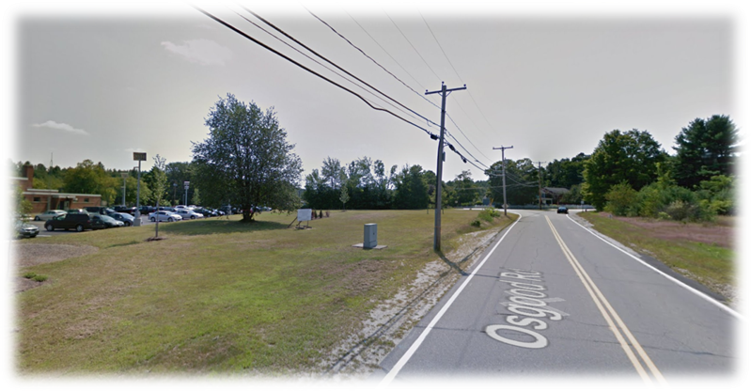
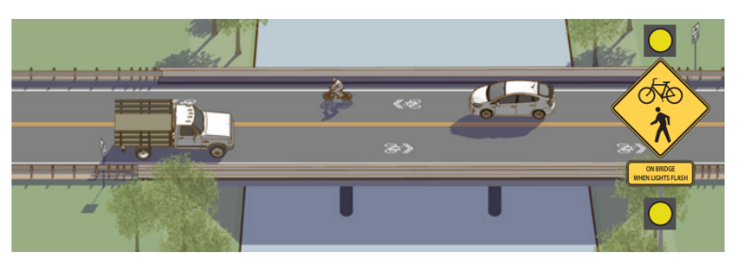
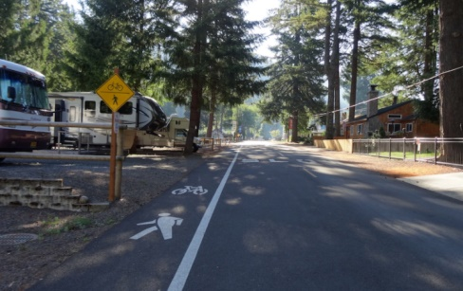
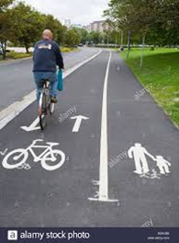
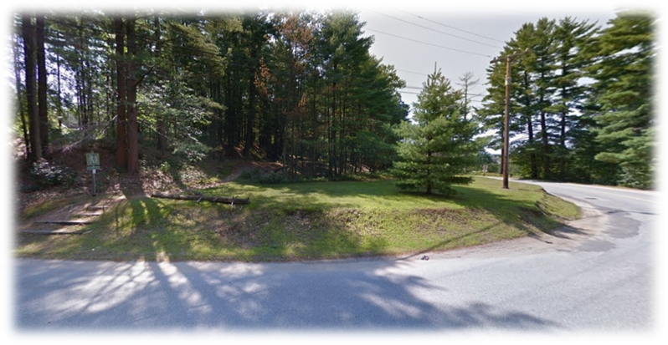
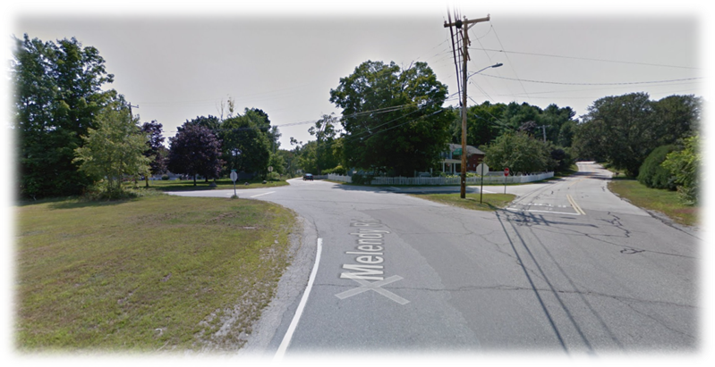
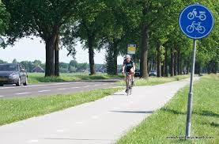
PROJECT SUMMARY
– Article #25 –

Slide 6
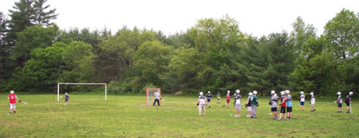
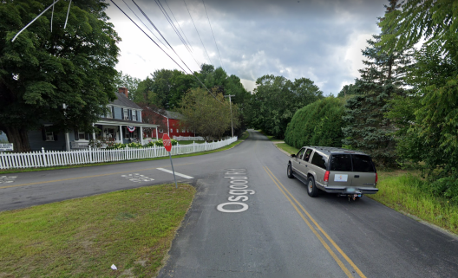
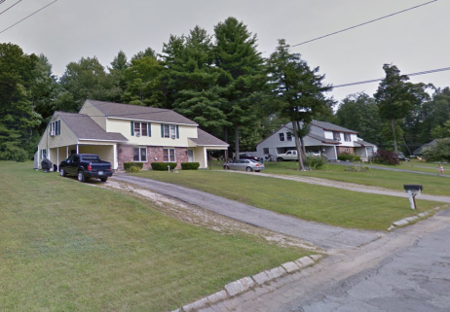
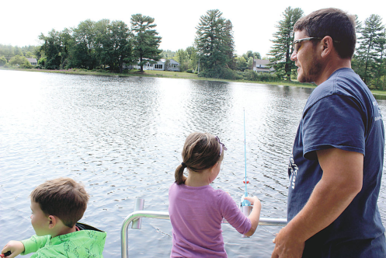
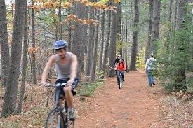
PROJECT LOCATION
The Milford School District uses Adams Park primarily for Lacrosse, Field Hockey, and Soccer practices
– Article #25 –
The pedestrian improvements are situated adjacent several established residential neighborhoods within ½ miles of the High and Middle Schools.
Provides direct access and connectivity to Osgood Pond, Granite Rail Trail, and downtown Milford.

Slide 7
PROJECT FUNDING
A Congestion Mitigation & Air Quality (CMAQ) Improvement Program Application submitted in September 2019.
Town notified in January 2020 by NHDOT that the project was selected for the CMAQ program.
Total Estimated Cost Of Project = $797,872.
CMAQ Program Funding - 80% / 20% match requirement. - 80% NHDOT Funded = $638,298.
- 20% Town Funded = $159,574.
The full cost of the project must be gross appropriated. If approved, the Town would then be reimbursed for the work completed.
The estimated completion of the project = Approx. 3 years. (Design/Engineering/Construction)
– Article #25 –

Slide 8
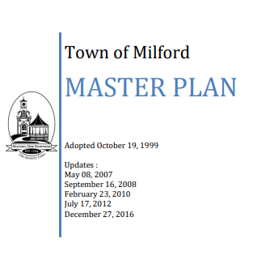
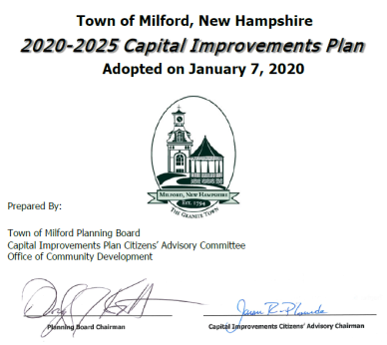
Relationship To Existing Local Plans & Regional Initiatives
The discussion and planning efforts involving this project has continued for more than two decades.
References:
1998 - “A Bicycle And Pedestrian Plan For The Town of Milford” prepared by Keene State College and the Milford Planning Department.
2005 - Nashua Regional Planning Commission Bicycle & Pedestrian Plan.
2005 - Milford Conservation Plan.
2006 - Nashua Regional Planning Commission Transportation & Community & Systems Preservation Study.
2014 - Milford Pedestrian, Bicycle, Trail & Recreation Connectivity Plan
2016 - Town Master Plan: Community Character & Transportation Chapters
Milford Capital Improvements Program Reports: 2011-2016, 2012-2017, 2013-2018, 2014-2019, 2015-2020, 2016-2021, 2017-2022, 2018-2023, 2019-2024, 2020-2025, 2021-2026
– Article #25 –

Slide 9
PROJECT SUPPORT
The proposed project has been supported by the following:
Milford Conservation Commission
Milford Planning Board
Milford Budget Advisory Committee
Milford School District
– Article #25–

Slide 10
QUESTIONS
– Article #25 –

