Slide 1
NHLTA Library of the Year!
2020

Slide 2
2020 Accomplishments
Removed asbestos tiles and installed carpeting
Replaced treads on main stairs
Painted
Cleaned, cleaned, cleaned!
Reconfigured the circulation and reference areas
Added an outdoor programming space
Weather protection for the entrance doors
Reinstallation of the “Lady” at the Soldiers Memorial
(Thank you to all the volunteers!!!)

Slide 3
Library Facility Issues
HVAC
$24,000+ over last 3 years for repairs
Non-efficient
Damaging leaks
Main electrical panel unsafe
Replacing HVAC requires electrical updates
Parts no longer available for brand currently installed
Electrical contractor states panel is no longer safe to work on
Plumbing
Non-working 3rd floor bathroom
No sprinkler system
No family restroom
Miscellaneous
Failed seals, cracked and leaking windows
Lack of Accessiblity: Ramp grade and Handicap parking spaces
No teen area, children’s programming space inadequate

Slide 4
2021 Warrant Proposal
Replace HVAC system
Remove existing chilled water system and associated air-side equipment
New state-of-the-art variable refrigerant system for simultaneous heating and cooling
26 zones of thermostatic control - higher comfort and reduced operational cost
Energy recovery ventilator - improve indoor air quality
Minor upgrades to existing boiler unit
Electrical Updates
Update service to 600A
Replace outdated and unsafe Federal Pacific panel
LED Lighting for main area lights (energy efficiency rebates available)
Parking lot lighting replacement
Replace emergency lighting units (code)

Slide 5
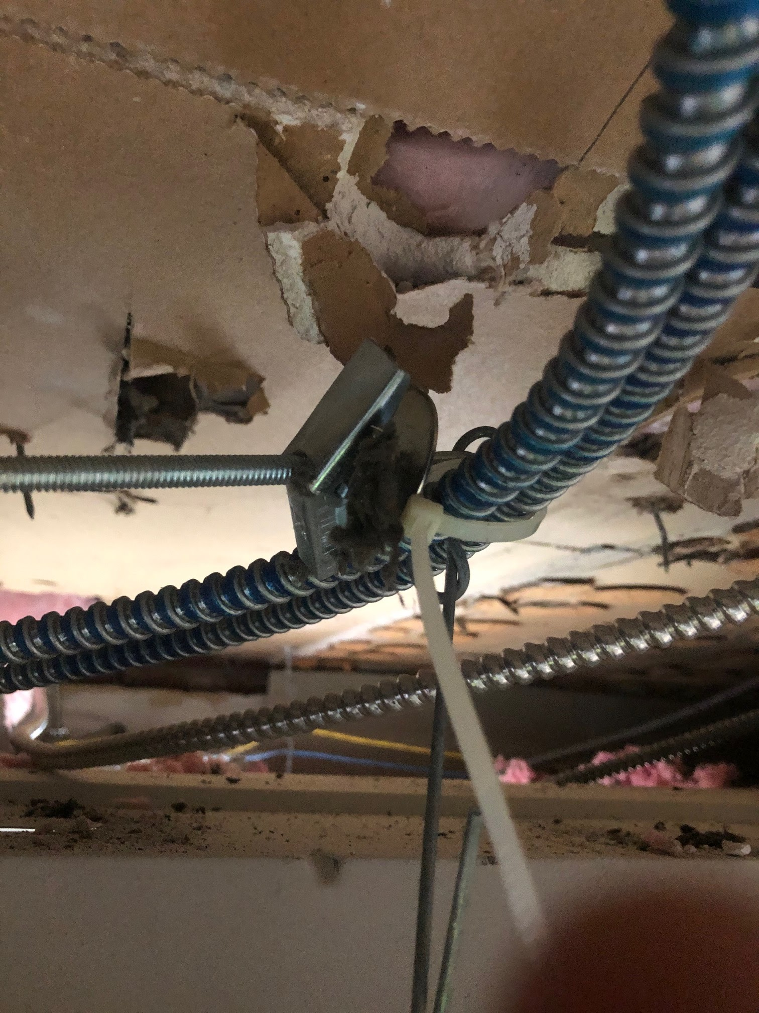
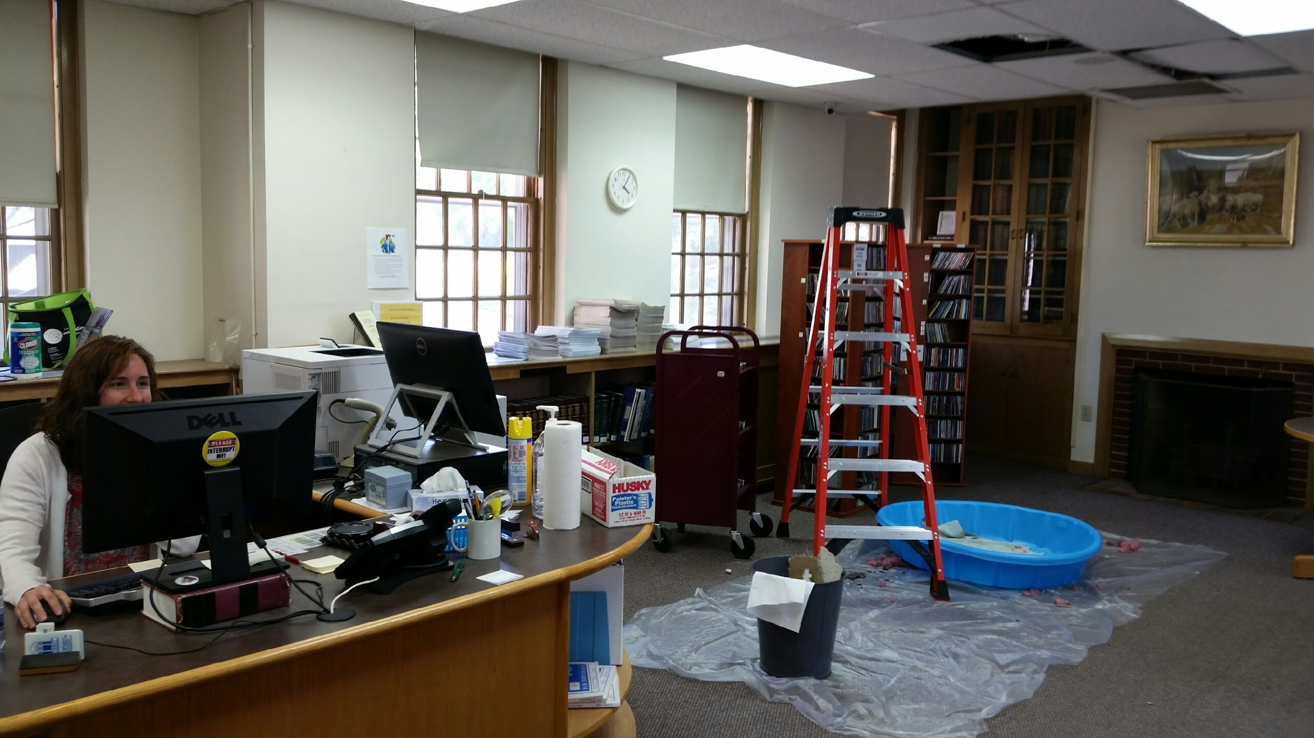
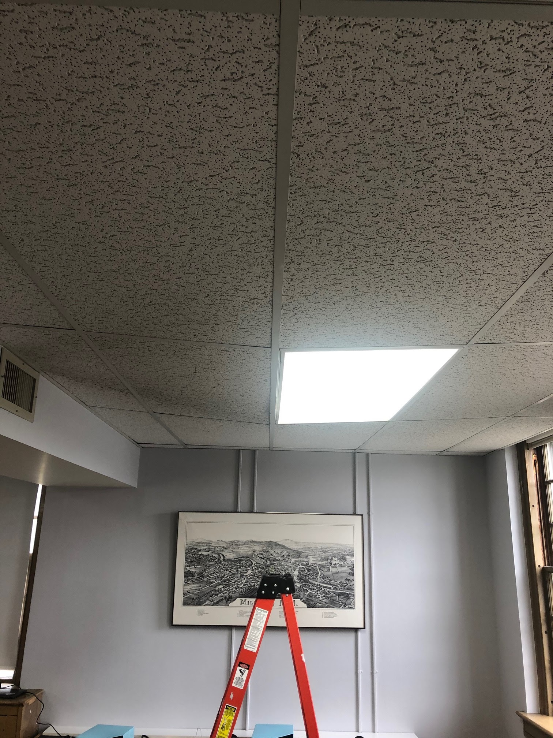
HVAC Leak Impact

Slide 6
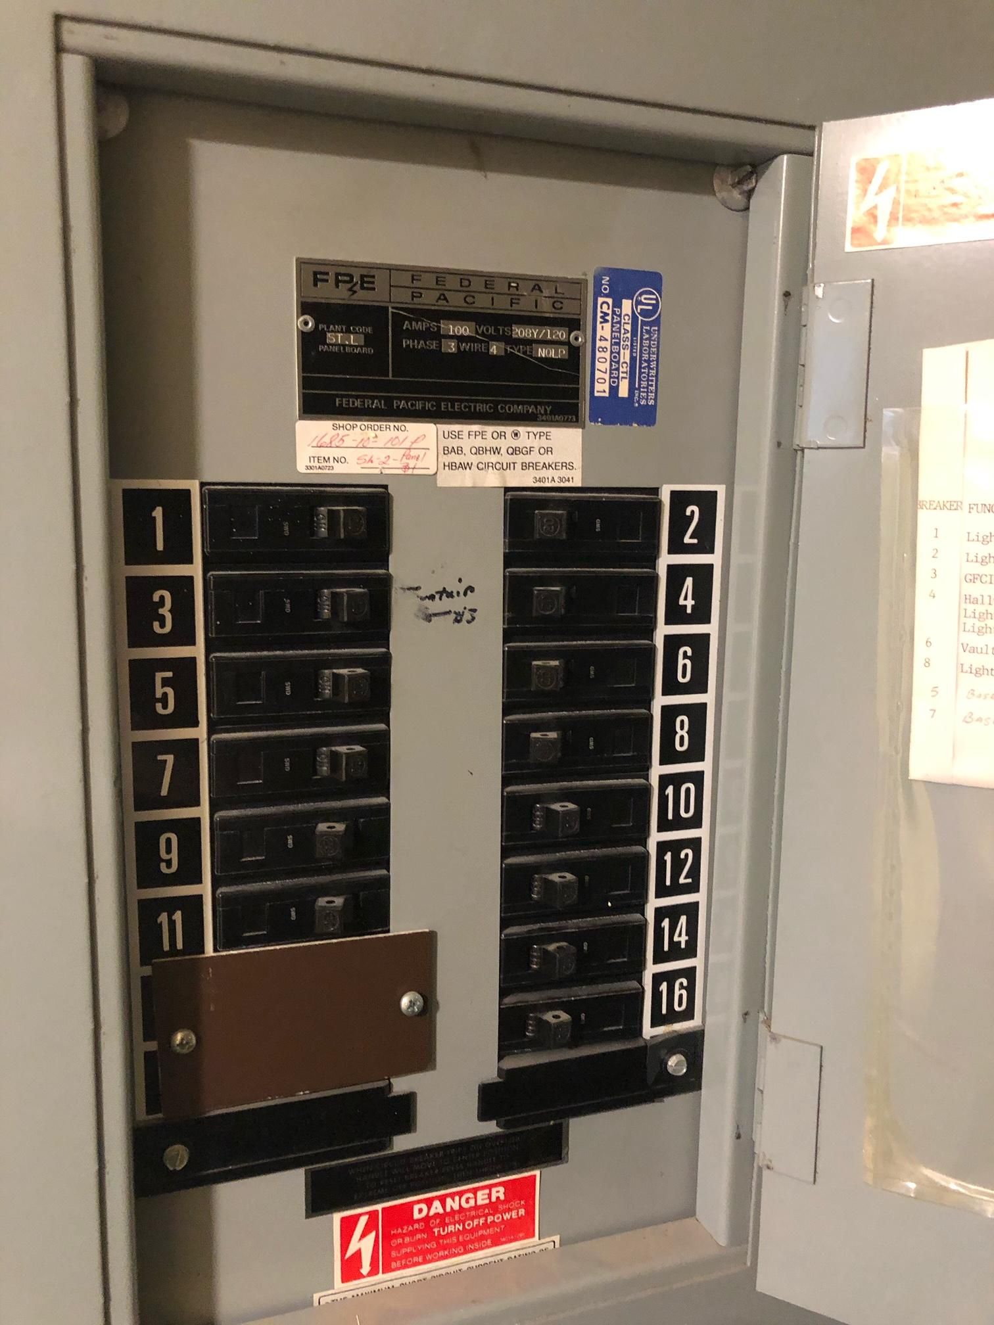
Electrical Panel Issues

Slide 7
$995,000 Bond - 10 Years
Total Estimated Cost: $1.29M
Balance covered from Library Trustee Trust Funds
$295,000 Estimated
Any amount over bond covered by Library Trustee Trust Funds

Slide 8
Project Cost Estimate Details
General Requirements
Demolition
Rough Carpentry
Finish Carpentry
Moisture Protection
Finishes
Mechanical
Electrical
Subtotal:
Bond:
MEC Fee:
Contingency:
BUDGET TOTAL:
$156,311.41
$20,148.10
$9,146,36
$1,230.07
$10,370.01
$54,465.54
$739,905.00
$134,980.50
$1,126,256.99
$22,684.00
$34,468.23
$107,377.66
$1,290,786.89

Slide 9
